Slide 1



Diabetes Risk Prediction Model
Machine Learning for Early Diagnostic Support
Course: CBIO313 Data Mining & Machine Learning
Presenter: Malak Amr (ID: 221001703)
supervised by : Dr. Muhammad Elsayeh

Slide 2
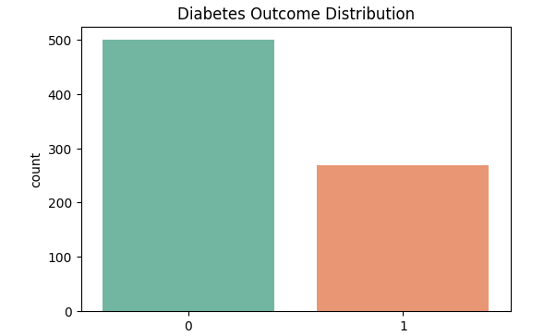
Project Objective & Dataset
Core Goal: Predict diabetes risk early using patient clinical indicators to enable timely medical intervention.
Non-Diabetic (0): 500 patients (~65%)
Diabetic (1): 268 patients (~35%)
Dataset Info (Pima Indians Dataset):
768 Patient Records , 8 Clinical Features
Key Indicators: Glucose, BMI, Blood Pressure, Insulin, Age, Pregnancies, Skin Thickness, Pedigree Function.

Slide 3
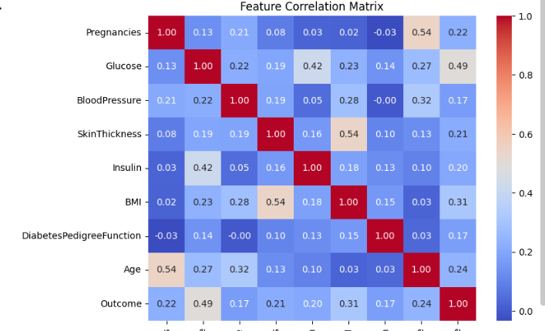
Preprocessing & Methodology
Data Preparation & Models
Data Preprocessing:
Imputation: Fixed zero values in physiological metrics (Glucose, BMI, BP) using median values.
Scaling: Applied StandardScaler for fair model feature weighting.
Data Split: 80% Training / 20% Testing (Stratified).
Classifiers Evaluated: Logistic Regression, Decision Tree, and Random Forest
Key Risk Factors (EDA Finding):
Check the bottom row (Outcome row):
Glucose: 0.49 (Strongest positive correlation with diabetes!)
BMI: 0.31 (Second strongest factor)
Age: 0.24
Glucose

Slide 4
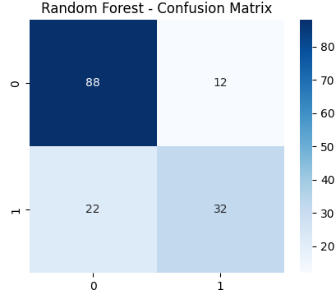
Results & Model Selection
Logistic Regressio
Baseline linear model achieving ~75% accuracy with reliable overall performance.
Decision Tree
Rule-based classifier achieving ~71% accuracy, capturing non-linear interactions.
Random Forest (Best)
True Negatives (88): Non-diabetic cases correctly predicted.
True Positives (32): Diabetic cases correctly predicted.
Total Correct Predictions: 88 + 32 = 120 out of 154 total test samples.
Overall Accuracy: ~78%
Top performer with ~78% accuracy, 71% precision, and superior feature stability.

Slide 5
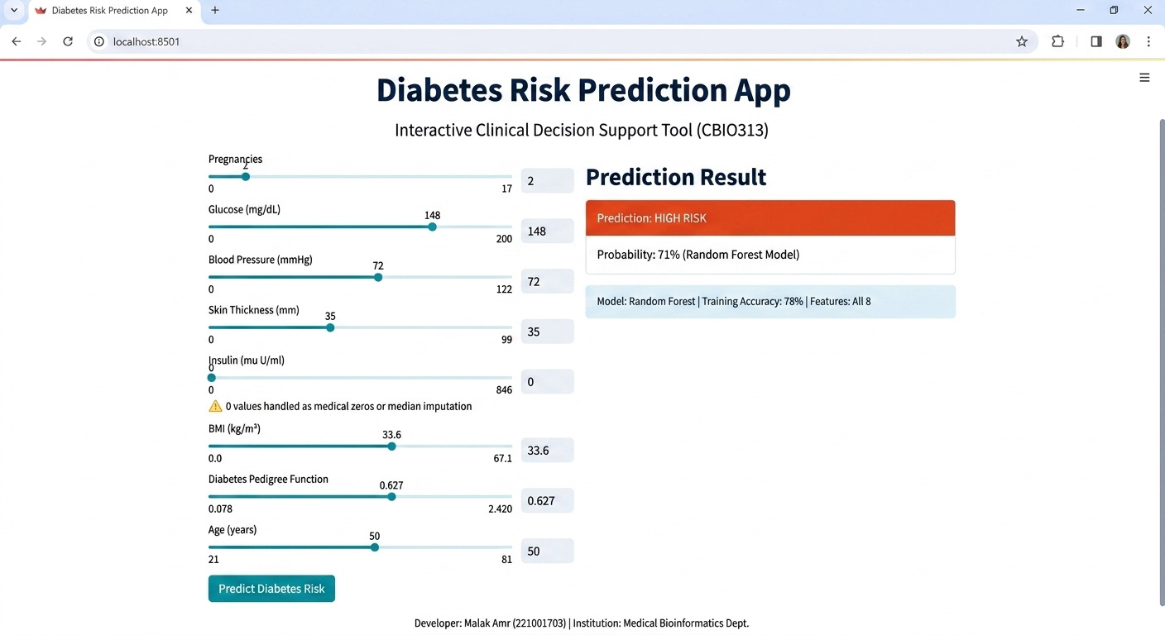


Interactive Web App
1. Built with Streamlit (app.py)
Converts the Random Forest machine learning pipeline into a real-time clinical decision support tool.
2. Real-Time Patient Evaluation
Allows clinicians to adjust 8 key parameters (Glucose, BMI, Age, Insulin, etc.) via interactive sliders.
3. Instant Risk Scoring
Outputs risk status (High Risk vs. Low Risk) alongside prediction probabilities to aid early diagnosis.
Figure: Live user interface displaying patient feature inputs and Random Forest model classification.

Slide 6
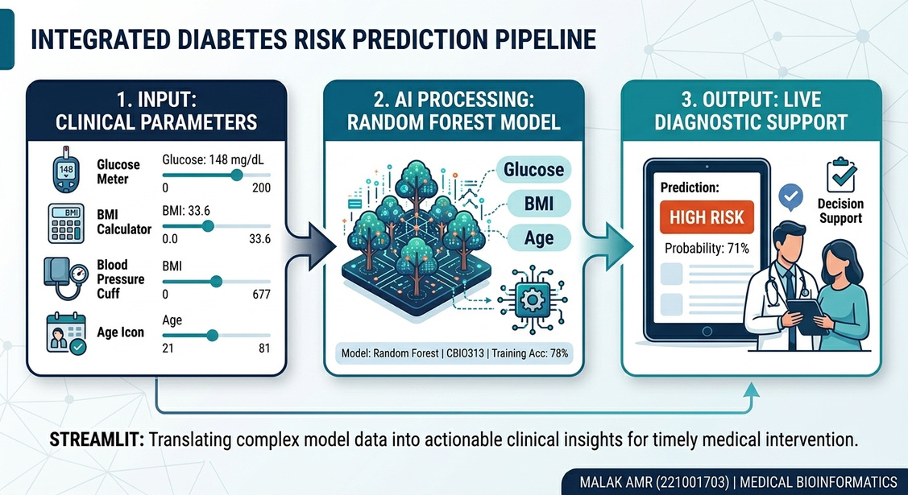
Conclusion & Future Directions
Project Summary & Impact
Developed an end-to-end clinical support system by preprocessing 768 patient records and training a Random Forest classifier. By integrating key features like Glucose and BMI, the pipeline yields an accurate early prediction tool deployed in real-time via Streamlit.
78%
8
Model Accuracy achieved with Random Forest classification.
Key Clinical Features integrated (Glucose, BMI, Age, etc.).

